Slide 1
Offline Multilingual Assistive Device for Visually Impaired Individuals.
Project Group No |  | Student Names
Project Name | An Offline, Multilingual Assistive Device for Visually Impaired Individuals. | 1 | D.M.C.K Dissanayake
Supervisor | Prof. Migara Liyanage | 2
Co-Supervisors | - | 3
Department of Mechanical Engineering, Final year Projects
Final Evaluation

Slide 2
Introduction
Problem Statement
Aim and Objectives
Literature Review
Methodology
Results and Discussion
Future Work and Conclusions
References

Slide 3
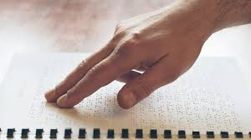
1. Introduction
Over 253 million people globally live with vision impairment, including 40–45 million who are completely blind.
Visual impairment limits education, employment, and quality of life.
Historical Innovations:
Braille System (19th century) by Louis Braille: a tactile writing system still widely used today.
White Cane (1921) by James Biggs: a mobility aid for the visually impaired.
Notes:
3.44% of world population (Stevens, Thomas & Liew, 2018)

Slide 4
2. Problem Statement
Limitations of Current Assistive Technologies:
  Dependency on External Technologies:
    Smartphones, visual interfaces and internet connectivity reduce accessibility in underserved areas.
  Limited Language Support:
    Most tools are optimized for English.
  Cost Barriers:
    Subscription-based and cloud-driven services are often unaffordable.
Notes:
Ray ban vision

Slide 5
3. Aim and Objectives
Aim:
Develop an offline, portable assistive device supporting multilingual text-to-speech in Sinhala and English.
Objectives:
  Develop a methodology to implement a device with Sinhala and English support for Visually impaired individuals.
  Exploring methods to implement image to text conversion and speech synthesis, minimizing the dependency on external technologies.
  Examine the suitability of the selected text recognition tool for an assistive device.
  Examine the capability of neural models for speech synthesis in Sinhala and English.

Slide 6
3. Aim and Objectives
Significance of the Research.
  Provides a solution for Sinhala-speaking visually impaired individuals.
  Enhances independence in education and professional settings.
  Overcomes the limitations faced by existing solutions by developing an offline method.
Potential Applications:
  Education: Converts textbooks into speech, aiding blind students in learning independently.
  Workplaces: Assists with document reading and navigation.
  Public Spaces: Enables access to signage and printed information without assistance.

Slide 7
4. Literature Review
Velmurugan et al. (2023): Developed a system using Raspberry Pi, Tesseract OCR, and eSpeak TTS for text-to-speech conversion.
  Reported text-to-speech accuracy of 77.2%.
  Strengths: Offline functionality.
  Limitations: English Language only , Stationary design
Konathala et al. (2023): Integrated wearable technology with Tesseract OCR, eSpeak, pyttsx, and ultrasonic sensors for mobility and literacy.
Strengths: Combined literacy and mobility.
Limitations: Relies on physical connectivity and stationary components.
Notes:
'A Next-Gen Automated Reading Companion for the Visually Impaired’
'Assistive glasses for blind people’

Slide 8
4. Literature Review
Prabhakar Manage et al. (2020): TTS system based on Tesseract OCR and google based speech synthesizers.
  Strengths: Low-cost, open-source approach.
  Limitations: Requires internet (cloud-based synthesis via gTTS)
Low-Resource Language Adaptation
Debnath et al. (2020): Used Tacotron2 and WaveGlow for Sanskrit TTS with transfer learning.
  Strengths: Successfully adapted for low-resource languages using transfer learning.
  Results: Achieved an MOS score of 3.38, demonstrating effective synthesis in resource-constrained scenarios.
Notes:
'An Intelligent Text Reader based on Python’
'Low-resource end-to-end Sanskrit TTS using Tacotron2, WaveGlow and transfer learning’

Slide 9
4. Literature Review
Research Gap derived from the Literature Survey:
The need for a methodology to develop an assistive device with;
  Offline functioning capabilities.
  Customized to use indoor and as well as outdoor settings,
  Multilingual support in both Sinhala and English for OCR and TTS.
  Use of neural models for speech synthesis customized for an assistive device.

Slide 10
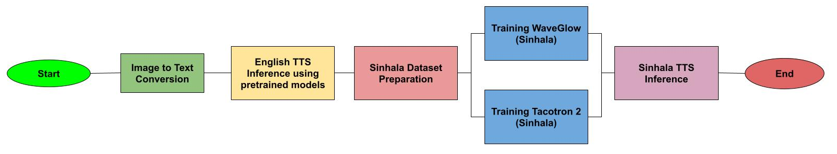
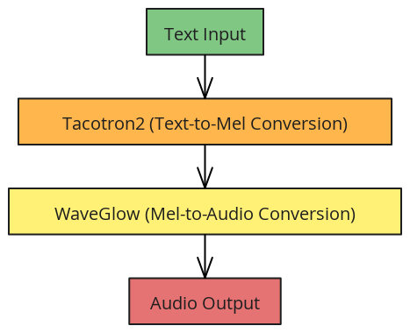
5. Methodology
Methodology of the research:

Slide 11
5. Methodology
Two Key Components:
Optical Character Recognition (OCR): Extracts text from images
Speech Synthesis (TTS): Converts extracted text into natural-sounding speech using neural models.
Offline Functionality: Focuses on eliminating external dependencies (smartphones, internet and cloud-based subscriptions).
Multilingual Support: Incorporates Sinhala and English for accessibility.

Slide 12
5. Methodology
Training and Hardware Platform
Training Platform: Google Colab Pro (GPUs to handle computationally intensive tasks.)
Hardware: Optimized for Raspberry Pi compatibility.
  Ensures portability and offline functionality.

Slide 13
5. Methodology
OCR Methodology - Tesseract OCR
Why Tesseract?
  Supports Sinhala Language.
  Open-source
  Offline functionality, unlike cloud-based solutions.
  suitable for Raspberry Pi.

Slide 14
5. Methodology
Preprocessing Steps for Tesseract- OCR :
Grayscale Conversion:
  Converts the image to grayscale to reduce complexity and eliminate color information that is irrelevant for text extraction.
Resizing:
  Resizes images to improve accuracy in recognizing smaller or stylized text.

Slide 15
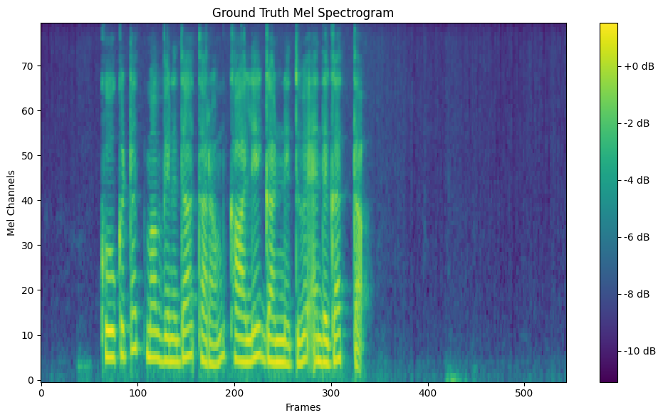
5. Methodology - TTS
Tacotron2:
  Converts text in to mel spectrograms
    Mel-spectrograms - applies a frequency-domain filter bank to audio signals that are windowed in time)
    Input – text
    Output – mel-spectrogram
WaveGlow:
  Flow-based neural vocoder
  Converts the mel spectrograms generated by Tacotron2 into audio (speech)
  Input – Mel-spectrograms
  Output – “.wav” Audio file
Notes:
Flow-based neural vocoder used to generate audio from mel spectrograms.

Slide 16
5. Methodology - TTS
English Speech Synthesis:
  Pre-trained Tacotron2 and WaveGlow models for high-quality speech synthesis.
  Used default limit for max decoder steps in tacotron2
  Handling long texts by diving the input into sections
  Dataset used – LJ speech dataset (Ito, 2017)
        - 24 hours of high-quality audio recordings from a single English speaker reading passages from public domain texts

Slide 17
5. Methodology - TTS
Sinhala Speech Synthesis:
The dataset used : Google’s Open Speech and Language Resources (OSLR, , 2017)
20 hours of audio data recorded by native Sinhala speakers.
Methodology:
Approach 1 – Training the model from scratch.
Approach 2 – Transfer Learning.
  Transfer learning applied to fine-tune pre-trained models with the Sinhala dataset.
Notes:
Open Speech and Language Resources, 2017)

Slide 18
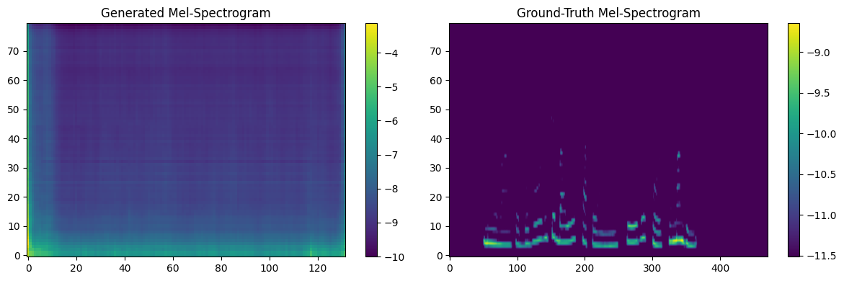
5. Methodology
Challenges in Sinhala TTS
Initial Sinhala TTS models produced poor audio quality.
  Compared the generated Mel Spectrograms with ground truth.
  Ground truth – visible frequency bands were present.
  Generated Mel spectrogram – representation of the noise

Slide 19
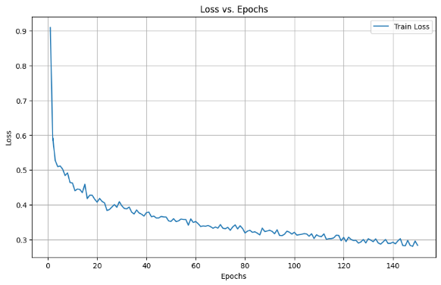
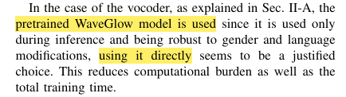
5. Methodology
Transfer Learning: Shifted to fine-tuning pre-trained Tacotron2 models for better results. (Debnath et. al, 2020 )
using the pre trained models on English dataset.
No additional training for WaveGlow model
(Debnath et. al, 2020 )
Training Loss curve for 150 epochs

Slide 20
6. Results and Discussions
Objective: The suitability of the selected text recognition tool (Tesseract OCR) for an assistive device.
Results based on test images under different lighting conditions.
Language | Summary of Tesseract- OCR Results
 | Total Words | Errors | Accuracy (%)
English | 621 | 30 | 95%
Sinhala | 528 | 112 | 78.8%
Notes:
lighting

Slide 21
6. Results and Discussions
Objective: Exploring methods to implement image to text conversion and speech synthesis, minimizing the dependency on external technologies.
Comparison of TTS Models:
Feature | Tacotron2 + WaveGlow | eSpeak | gTTS
Type | Neural Network | Rule-Based | Cloud-Based
Naturalness | High | Low | Moderate
Intelligibility | High | Moderate | High
Support for Sinhala | Yes (with training) | No | Yes
Offline Functionality | Yes | Yes | No
Customization | Fully customizable | Minimal | None
Hardware Requirement | GPU Recommended | CPU | Cloud-Dependent
Deployment on Raspberry Pi | Yes | Yes | No

Slide 22
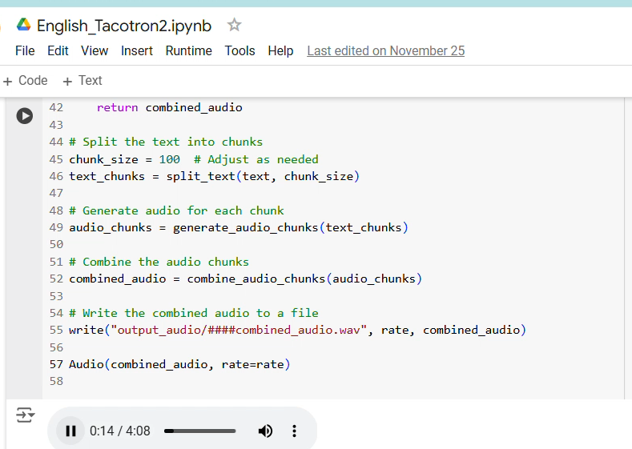
6. Results and Discussions
Results of Speech Synthesis – English
Performance on English TTS – 97.4 % accuracy
Audio Output Analysis:
The synthesized audio had a duration of 4 minutes, consistent with the input text.
• Out of the 582 words, 15 errors were identified
• 7 major errors (mispronunciations or incorrect emphasis).
• 8 minor issues (slight inconsistencies or unnecessary pauses).

Slide 23
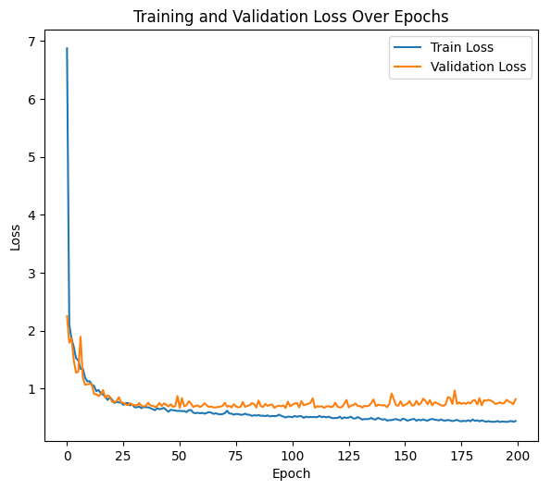
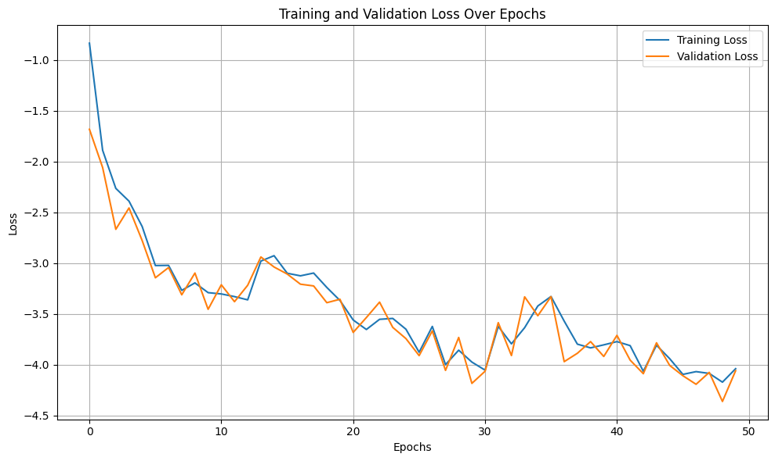
5. Methodology - TTS
Sinhala Speech Synthesis: - Initial Training
Tacotron 2 training metrics – 200 epochs
WaveGlow training metrics – 50 epochs

Slide 24
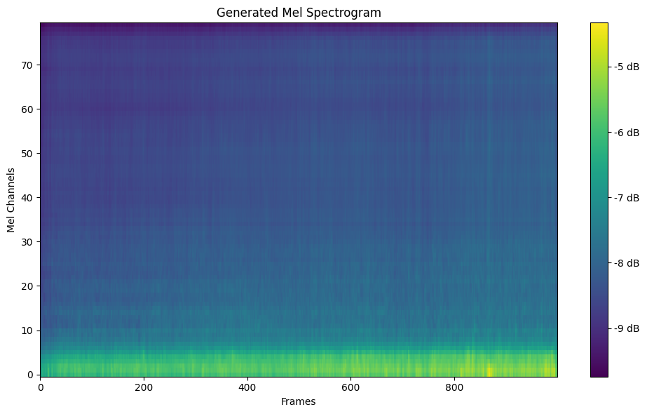
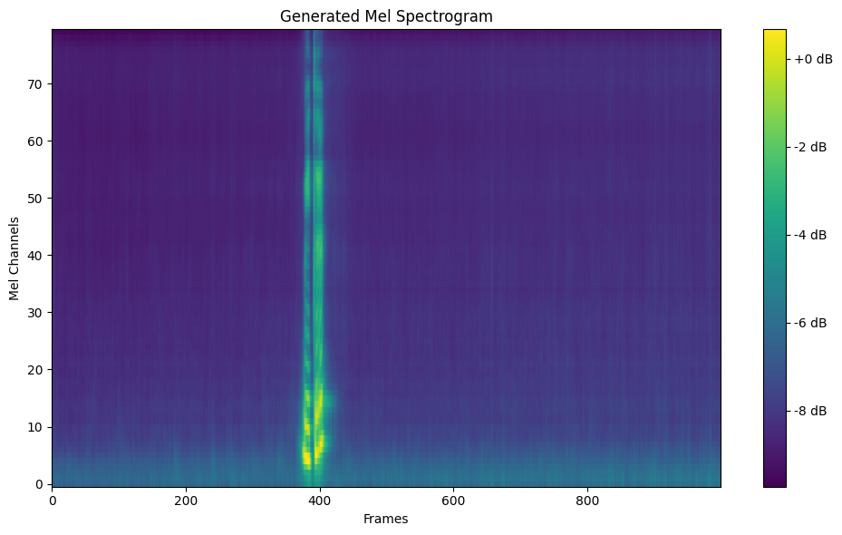
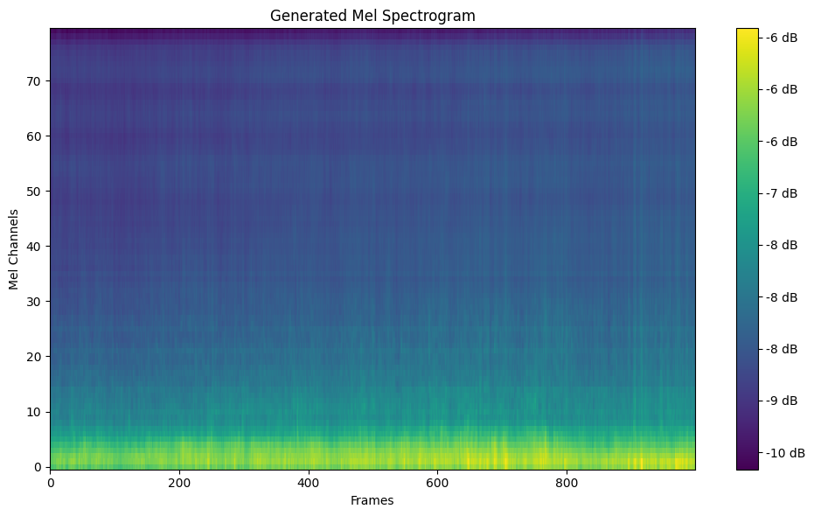
6. Results and Discussions - Sinhala Speech Synthesis
Mel-spectrograms comparison of Transfer Learning
100th epoch checkpoint
50th epoch checkpoint
150th epoch checkpoint
Ground truth of the tested text

Slide 25
7. Future work and Conclusions
Challenges Encountered:
Alignment Issues: Difficulty in aligning mel-spectrograms in Sinhala TTS.
Symptoms: Smooth, low-energy spectrograms, indicating poor acoustic feature capture.
Computational Constraints: Limited resources (Google Colab Pro, time) hindered extended training.
Achievements:
Multilingual OCR & English TTS: Successfully developed and optimized for offline use.
Sinhala TTS: Achieved foundational progress with transfer learning.
Suitability for Hardware: Models are compatible with Raspberry Pi for future deployment.

Slide 26
7. Future work and Conclusions
Future Work and Recommendations:
Extended Training and Optimization.
  Extend training beyond 150 epochs, using a smaller batch size for improved audio quality.
  Comparison: Studies like Debnath et al. (2020) achieved improvements with 430 epochs and a batch size of 8.
Dataset Expansion.
  Focus on custom TTS and OCR datasets for improved model adaptability.
Hardware Implementation.

Slide 27
8. References
World Health Organization (2003) 'Up to 45 million blind people globally - and growing', World Health Organization. Available at: https://www.who.int/news/item/09-10-2003-up-to-45-million-blind-people-globally---and-growing (Accessed: 20 April 2024).
Velmurugan, S.N., Sekar, S., Jebaraj, B.S., Vishnu Shakthi, D., Azarudeen, K. and Shanmuga, R.B. (2023) 'A Next-Gen Automated Reading Companion for the Visually Impaired', in 2023 International Conference on Research Methodologies in Knowledge Management, Artificial Intelligence and Telecommunication Engineering (RMKMATE), Chennai, India, pp. 1–7. doi: 10.1109/RMKMATE59243.2023.10369761 (Accessed: 31 March 2024).
Manage, P., Ambe, V., Gokhale, P., Patil, V., Kulkarni, R.M. and Kalburgimath, P.R. (2020) 'An Intelligent Text Reader based on Python', in 2020 3rd International Conference on Intelligent Sustainable Systems (ICISS), Thoothukudi, India, pp. 1–5. doi: 10.1109/ICISS49785.2020.9315996 (Accessed: 31 March 2024).
Amarasinghe, C.K., Pinto, R.D.S.P. and Sudusinghe, K.N. (2022) 'Guardian - Smart Assistant Tool for Visually Impaired People', in 2022 4th International Conference on Advancements in Computing (ICAC), Colombo, Sri Lanka, pp. 429–434. doi: 10.1109/ICAC57685.2022.10025262.
Konathala, S.K., Kondepudi, Z., Vommi, B., Genjii, Y., Dogga, R. and Viyyapu, A. (2023) 'Assistive glasses for blind people', in 2023 7th International Conference on Computing, Communication, Control and Automation (ICCUBEA), Pune, India, pp. 1–6. doi: 10.1109/ICCUBEA58933.2023.10392252 (Accessed: 21 November 2024).
Shen, J. et al. (2018) 'Natural TTS synthesis by conditioning WaveNet on mel spectrogram predictions', in IEEE International Conference on Acoustics, Speech, and Signal Processing (ICASSP).
Debnath, A., Patil, S.S., Nadiger, G. and Ganesan, R.A. (2020) 'Low-resource end-to-end Sanskrit TTS using Tacotron2, WaveGlow and transfer learning', in 2020 IEEE 17th India Council International Conference (INDICON), New Delhi, India, pp. 1–5. doi: 10.1109/INDICON49873.2020.9342071 (Accessed: 21 November 2024).
Google, Inc. (2015-2016) 'Sinhala TTS: Sinhalese multi-speaker TTS corpora'. Available at: https://openslr.org/30/ (Accessed: 22 August 2024).
Ito, K. (2017) 'LJSpeech: A public domain speech dataset'. Available at: https://keithito.com/LJ-Speech-Dataset/ (Accessed: 23 July 2024).
Stevens, A., Thomas, S. & Liew, S., 2018. The prevalence of visual impairment in Australia. PMID: 5820628. Available at: https://pmc.ncbi.nlm.nih.gov/articles/PMC5820628/ [Accessed 9 December 2024].

Slide 28
Thank you!

